Slide 1
MRA Annual Meeting 2016
March 14, 2016

Slide 2
Agenda
Roll Call & Certification of Proxies
Proof of Notice of Meeting
Approval of Minutes from 2015 Annual Meeting
Introductions and Officer Reports
President's Report
Treasurer's Report
Activities and Programming
Special Tax Resolution 70-604
Election of TWO Directors
Owner's Forum
Adjournment

Slide 3
President's Report
Reserve Expense Update
New Law Firm (12 months Results)

Slide 4
Major Reserve Expenses Update
Pump Room project completed within 10% of projected budget
SPA Heater initially undersized causing delay in full functionality
Several unexpected code violation issues caused additional expense
Addition of remote safety shutoff and monitoring
New Security System
Camera Monitoring
One couple caught
No damage overnight
Exterior Lighting LED’s where possible
New Photo ID System
100% compliance After initial resistance with residents objecting to children's pictures
Much less abuse of system
Increase in guest fees

Slide 5
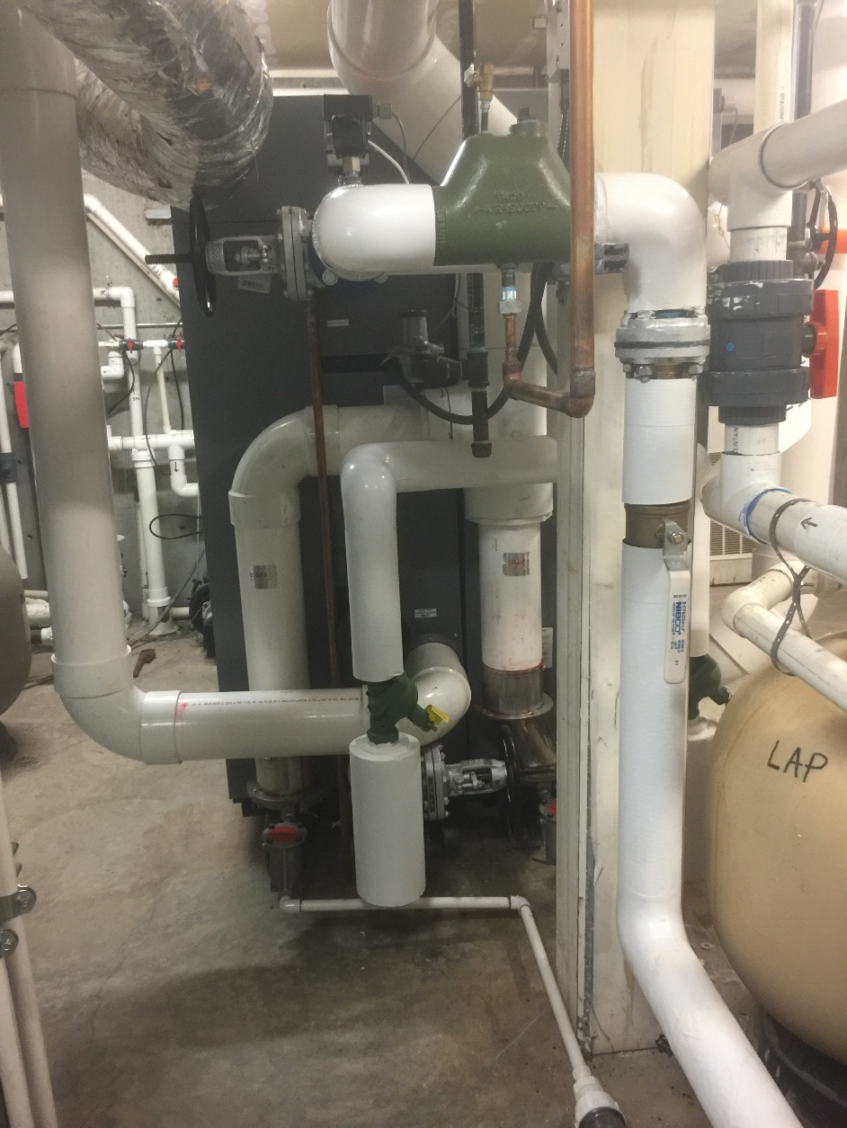
New High Efficiency Boilers
Exhaust outside through PVC
Dual 98% efficient Boilers
Combustion air from outside

Slide 6
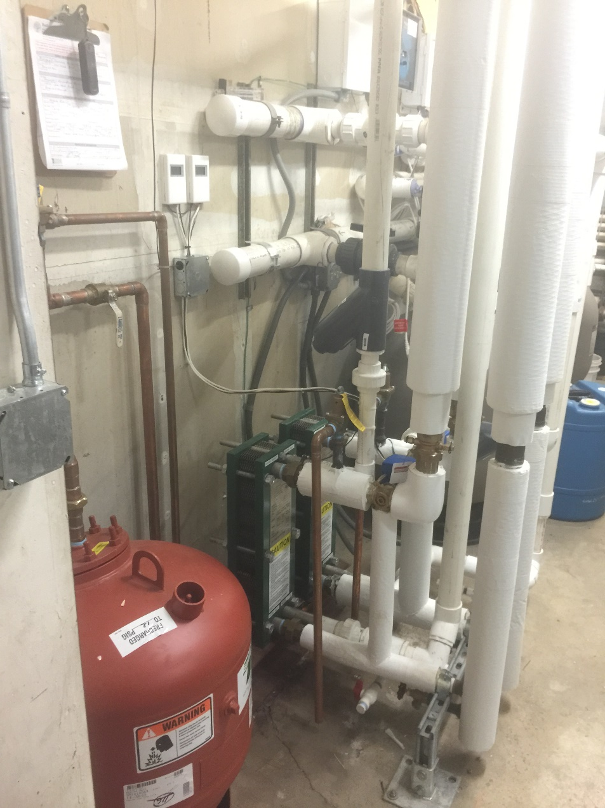
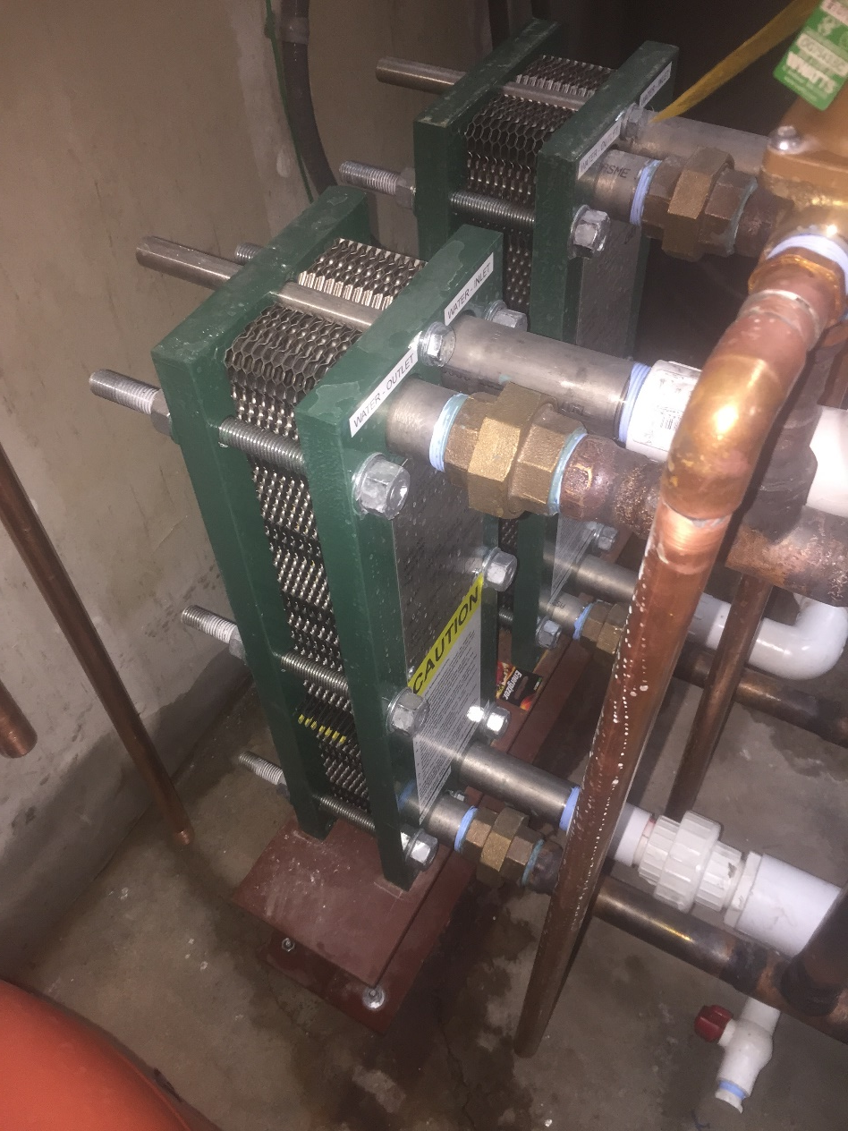
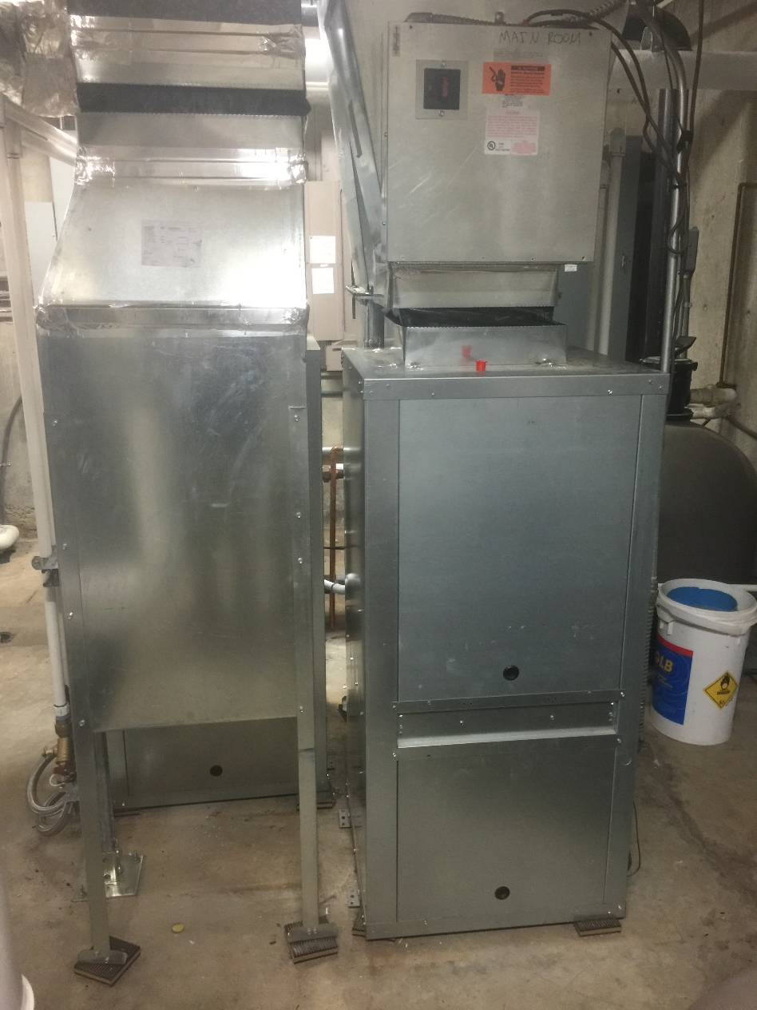
Pump Room After
Titanium Heat Exchangers
Heat Pumps
Heat Exchangers
Water Source

Slide 7
New Law Firm
Prior to 2015 MRA spending ~$10,000 per year on legal fees for collections
With Vial Fotheringham we only paid approximately $300.

Slide 8
Treasurer's Report
Operating and Reserve Funds
Separation of functions
Reserve Budget

Slide 9
Operating and Reserve Funds
Two types of funds within MRA
Day-to-day operations are taken care of by the Operating Fund
Major or long-term projects are handled by the Reserve Fund
Separate Bank Accounts
An Operating account maintained at Bank of America
A Reserve Account maintained at OnPoint Credit Union

Slide 10
Separation of Accounting
Operating and Reserve Accounts and bookkeeping were separated in 2014
MRA tracks each fund separately although borrowing happens between the funds
We don’t collect enough funds from dues before they are needed
Payback of short term loans from reserves happens within 3 months of the calendar year
MRA has an independent bookkeeper and association manager
MRA has a board treasurer that is a CPA overseeing both

Slide 11
Operating Fund
This fund is used to pay for the services that help carry out the everyday functions of the MRA. These include, but are not limited to:
Contracted services
Landscape maintenance/insect treatment
General maintenance of common areas < Reserve Threshold
Gate, fence, pool, lighting, and plumbing repairs
General Pool maintenance
Accounting
Legal
Property management of Hometown Center
Insurance and taxes
Utility expenses
Gas, electric, water and cable
Internet/phones (cost shared with MOA)
Office expenses
Postage, office supplies
Staff Salaries (association manager, lifeguards, pool monitors)
*Reserve Threshold is currently $500. It is a value set by the board and subject to change.

Slide 12
Reserve Fund
This fund is used for larger scale projects
Replacement and repair plus unpredictable items over Reserve Threshold*
Strict criteria for use based on:
Community bylaws
State regulations
Decisions of the Board
used to pay for expenditures that Don't occur on an annual basis or Fall under special exemptions
Some examples of reserve fund use are:
Roof replacement on common area buildings
Pump room project at the pool
New playground equipment
Replacing fencing in MRA controlled areas
Painting of MRA owned buildings, such as the Hometown Center
Major landscaping projects, like the field restoration
Construction and major renovation such as sidewalk projects
*Reserve Threshold is currently $500. It is a value set by the board and subject to change.

Slide 13
Dues and Dues Allocation
Currently homeowners make two dues and special assessments payments per year
The twice annual payments combine dues and special assessment into one payment
The dues portion can increase annually by the CPI or 4% whichever is smaller
Currently the dues portion is $190 every 6 months
It will rise to $191for the April bill (0.7%)
Raising this number in excess of the above guidelines takes a vote of 75% of residents
Under our bylaws the board could override this but the current board has chosen not to

Slide 14
Special Assessments
Special assessment is determined by the board with our outside reserve study company
Ensures there will be enough funds to repair/replace capital items when they wear out
The reserve study looks out 30 years and ensures the Reserve Fund never gets too low
The October 2015 special assessment was $85
the April special assessment will remain at $85 based on final 2016 study

Slide 15
Balance Sheet Assets

Slide 16
Balance Sheet Liabilities

Slide 17
Operating Income/Budget

Slide 18
Operating Expenses (1)

Slide 19
Operating Expenses (2)

Slide 20
Operating Expenses & Non-cash

Slide 21
Reserve Budget

Slide 22
Reserve Forecast

Slide 23
activities and programming
2016 Activities schedule
Aquatics programs

Slide 24
2016 Community Activities
March 26 Easter Egg Hunt - 10:00 am
Summer months flicks on the field
November 24 Turkey Trot (5K)
December 10 breakfast with Santa
Please contact Kristin Kebbe, association manager, if you would like to Sponsor or Volunteer for these events.

Slide 25
Movies at Murrayhill
Fridays once a month this summer
June 24th
July 22nd
August 19th
There will be limited concessions such as popcorn, drinks and glowsticks
Look for a survey coming to in boxes soon where you can vote for the movies that will be shown!

Slide 26
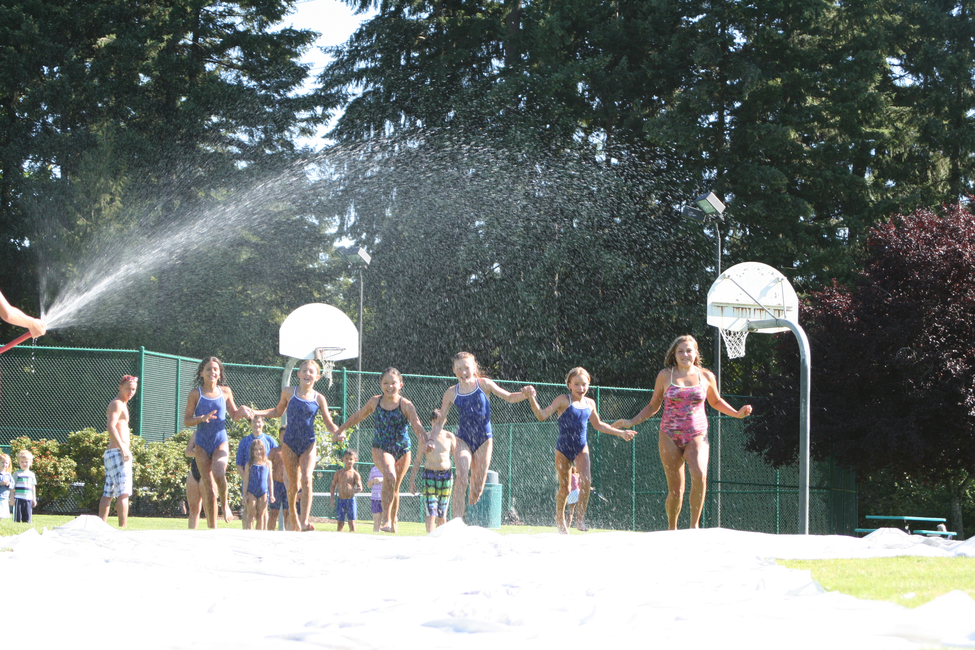
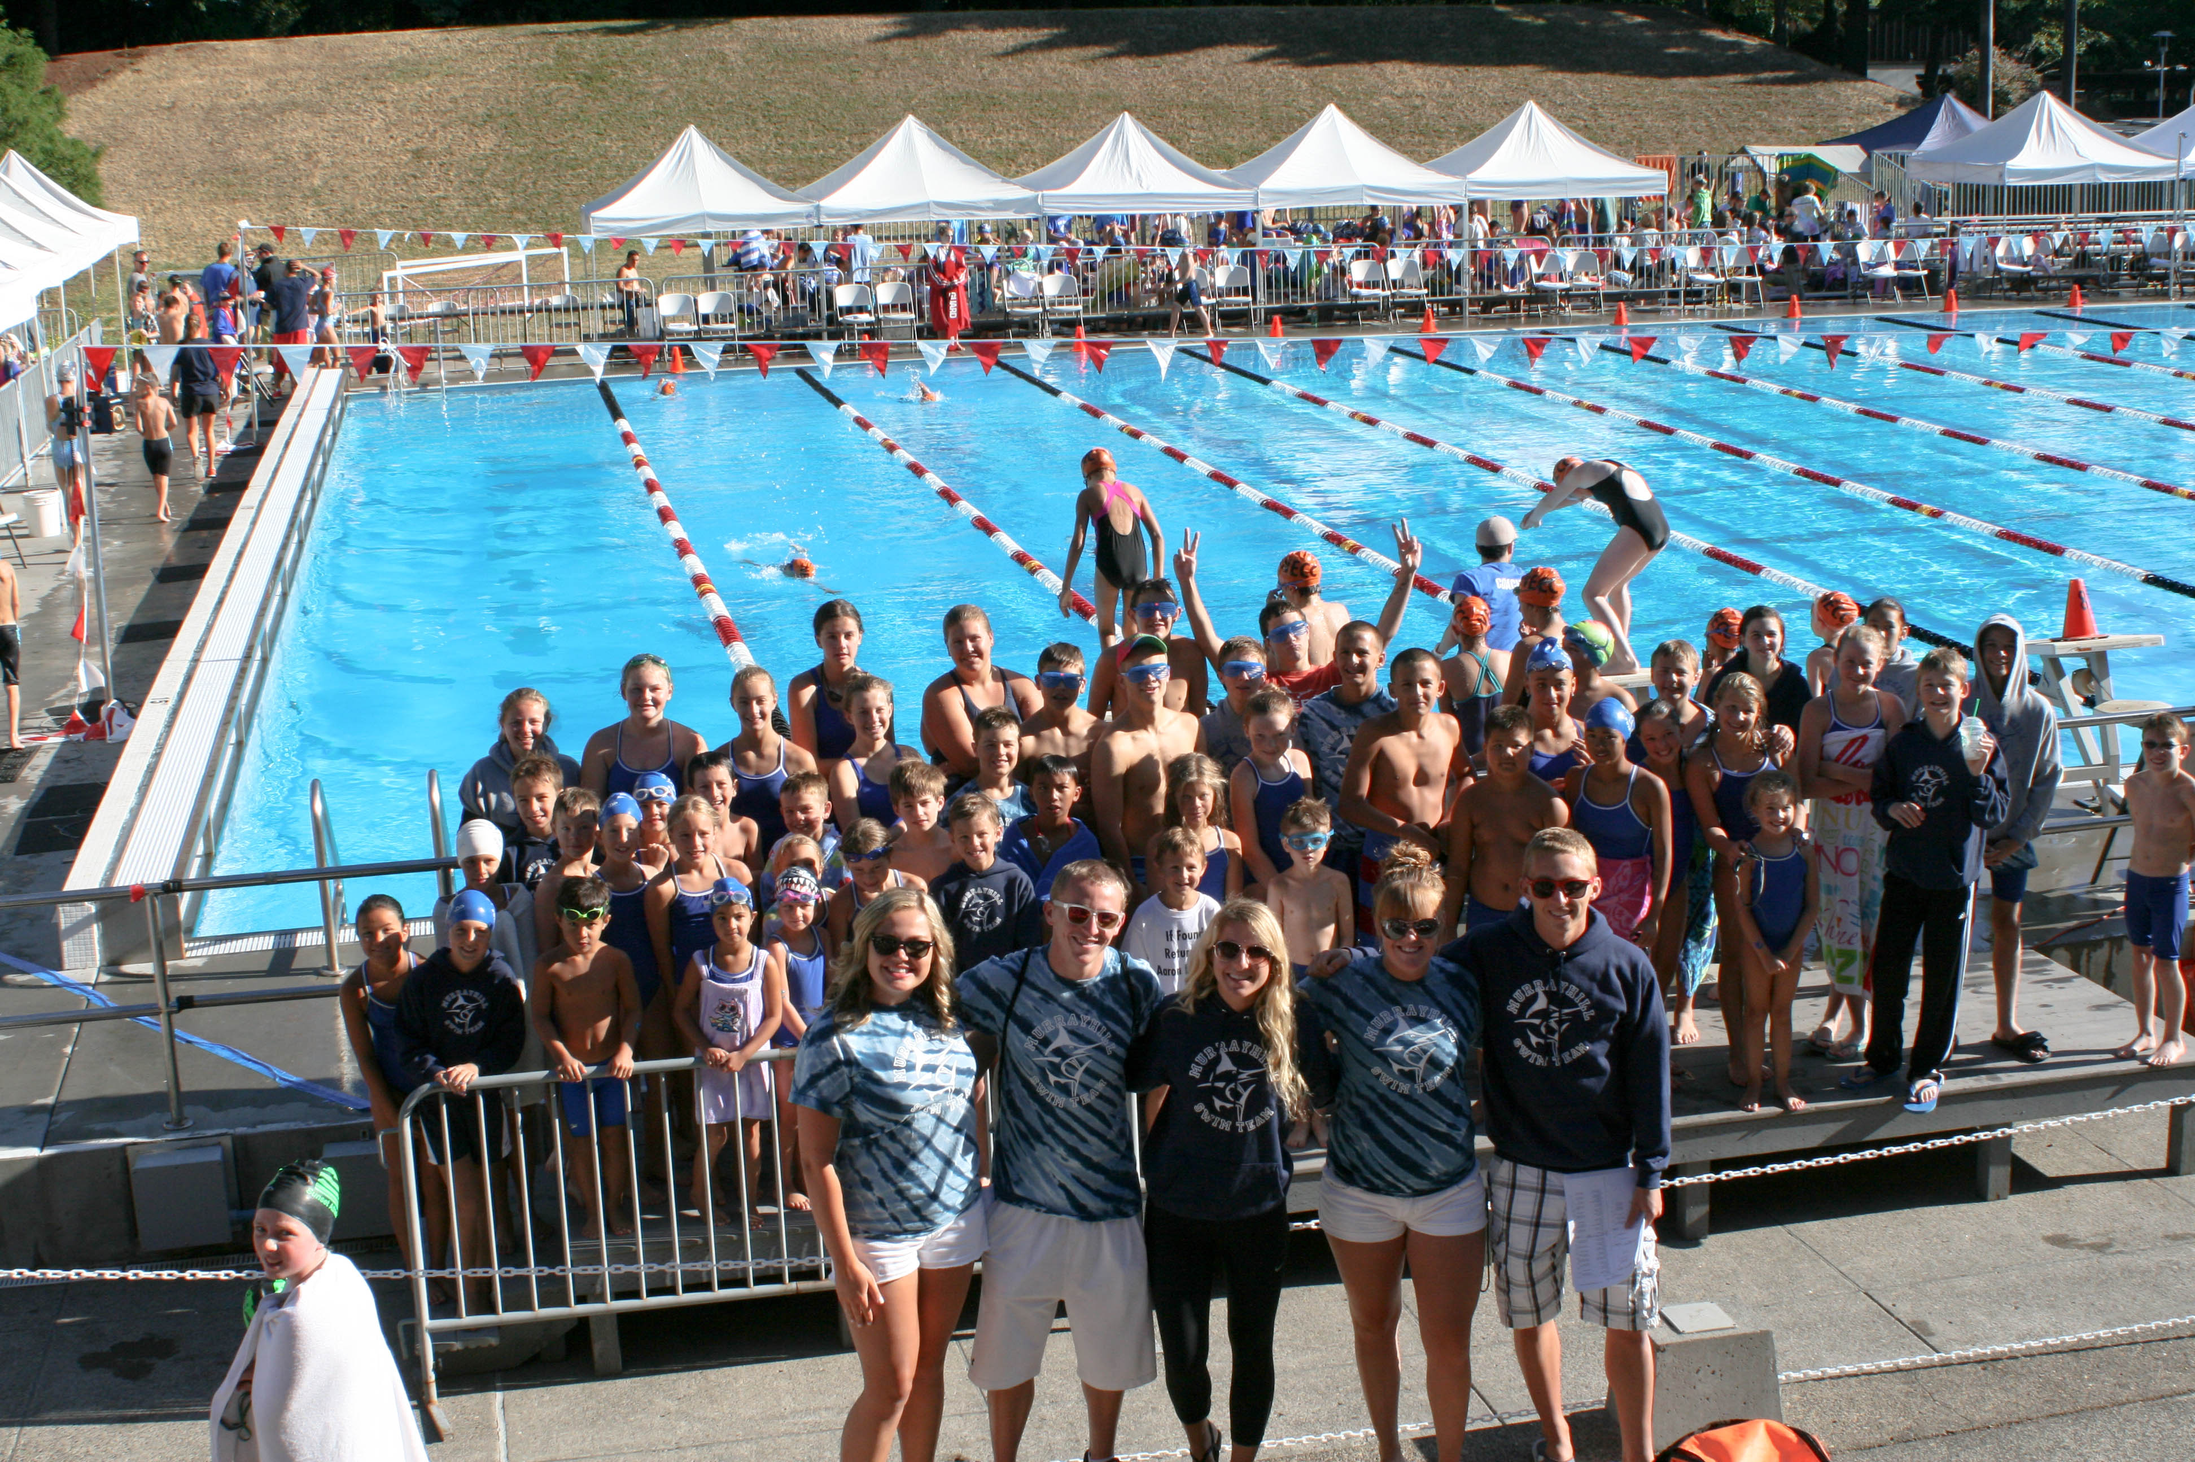
Aquatics Programs
Marlins Swim Team
Record breaking 110 swimmers on the team during the 2015 season
End of season party with family spaghetti feed
1st place at the district championship Meet!
Swim Lessons
Group, Semi-private, and private lessons: over 120 kids in 2015
coached adult lap swim class two evenings a week

Slide 27
Special Tax resolution 70-604

Slide 28
Election of two MRA Board Members
Selection of election Officials (not Necessary)

Slide 29
Owner's Forum

Slide 30
Adjournment

