Slide 1
Murrayhill Recreation Association
2018 Annual Homeowners Meeting

Slide 2
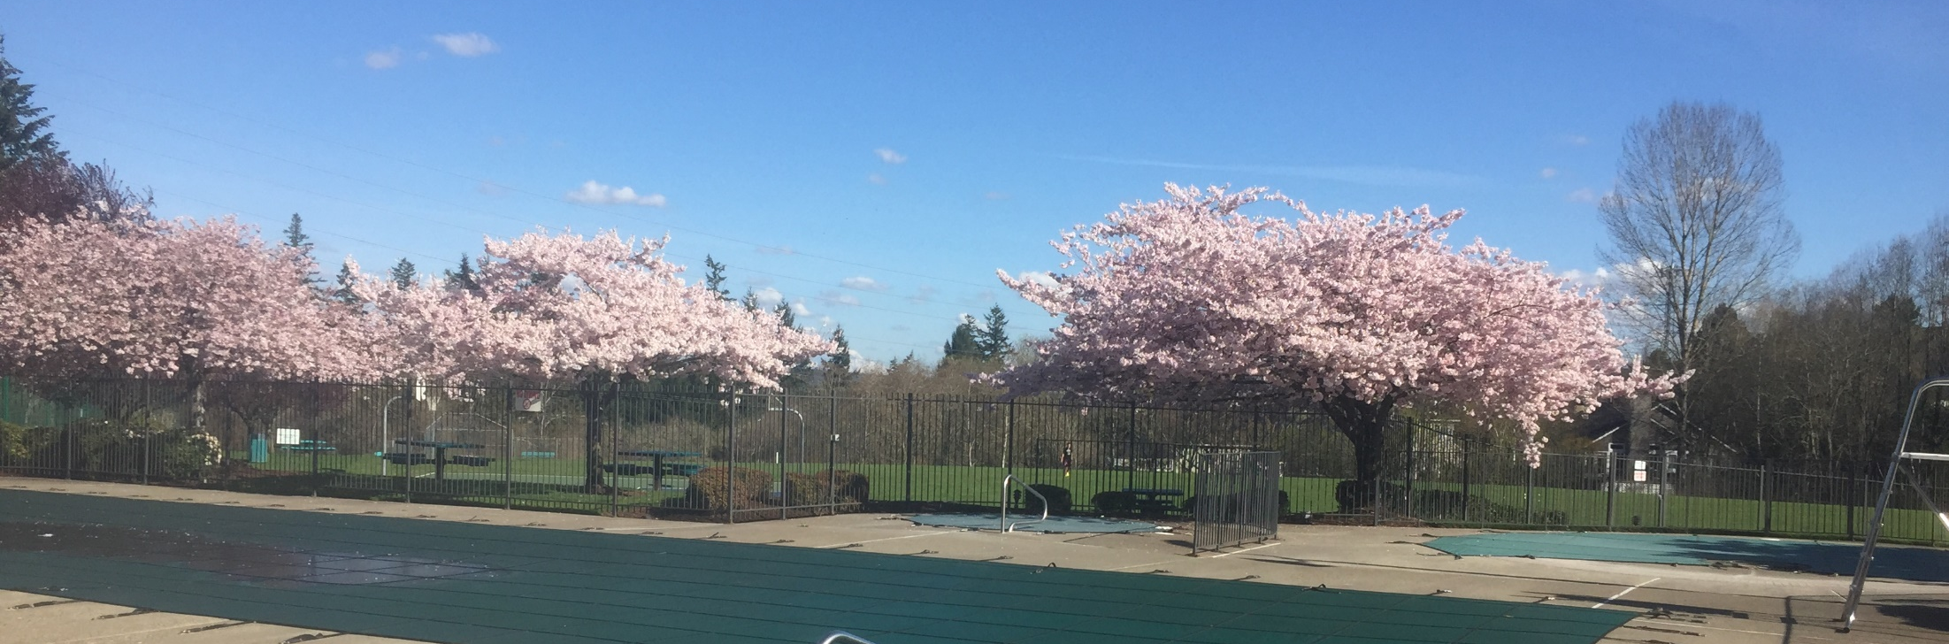
Welcome

Slide 3

Roll Call & Certification of Proxies

Slide 4
Proof of Notice of Meeting
SAVE THE DATE
Murrayhill Recreation Association – Annual Homeowners Meeting March 19th 6:30 pm – Hometown Center
The MRA Board of Directors invite you to attend the MRA Annual Homeowners Meeting on Monday, March 19, 2018 at 6:30 pm in the Hometown Center. The MRA Board of Directors will conduct the annual elections and present a 2017 overview as well as an outlook for 2018.
The Board of Directors of the Murrayhill Recreation Association are hereby providing you notice that one (1) Residential Director position on the Board of Directors will be available. The position of Director Tabrah is expiring. The MRA board is made up of five Murrayhill homeowners who are elected to three year terms of office. Elections will be held at the Annual Meeting for one Board position in March 2018. A nominating committee has been appointed by the Board for the purpose of nominating prospective Directors. Prospective Directors may also be nominated by a petition signed by at least 25 MRA Members; petitions must include a biographical statement by the nominee. For more information or to discuss your interest with the nominating committee please email am@murrayhillrec.com. The Board must receive all nominations, petitions and accompanying materials by Feb 19th, 2018.
Official notification of the MRA Annual Meeting including the candidate names and biographical statements will be mailed on or about February 26, 2018.
If you have any questions, please contact the MRA Association Manager at (503) 579-0985.
Sincerely,
The MRA Board of Directors
2018 Murrayhill Recreation Association | 11010 SW Teal Blvd | Beaverton, OR 97007 | (503) 579-0985 | am@murrayhillrec.com

Slide 5
Approval of 2017 Minutes

Slide 6
Read-In Motions
2018 Operations Budget
2018 Reserve Budget

Slide 7
President’s Report
HTC Project Update

Slide 8
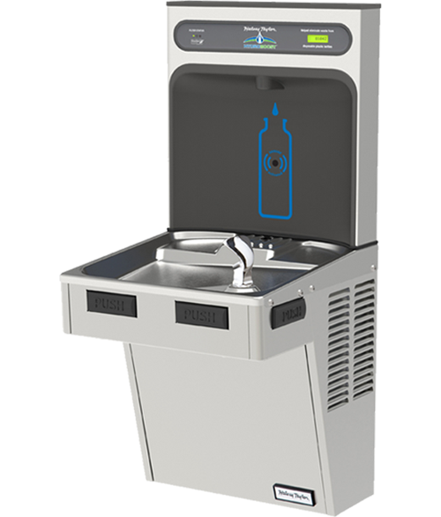
President’s Report
Major Reserve Expense Update
  2017
    Underground Wiring Project
    New Roof and Gutters
    Metal Fencing Repairs and Replacement
    Replaced Salt/Chlorine Generators and Filters
    Climbing Structure Platform Replacement
    Water Fountain and Filling Station

Slide 9
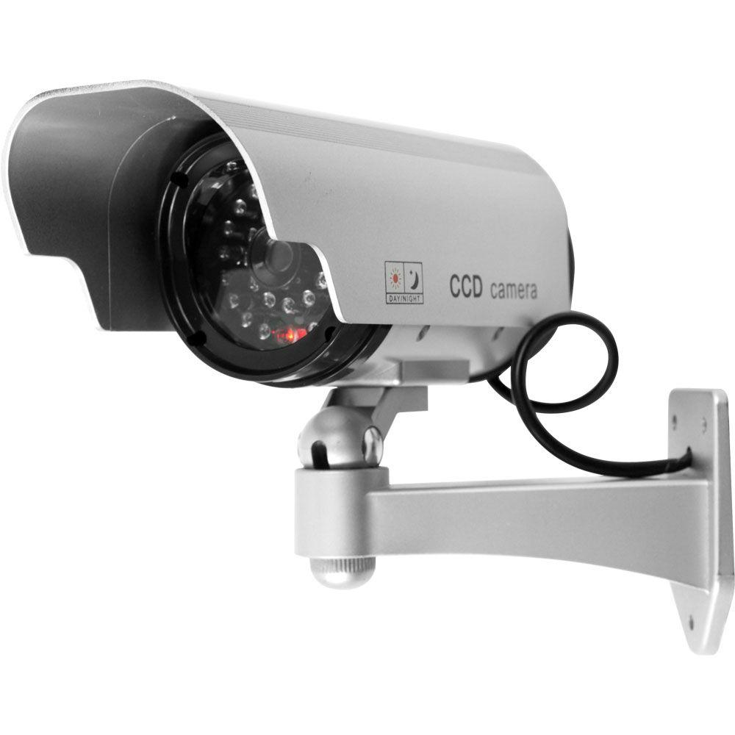
President’s Report
Major Reserve Expense Update
  2018 Completed
    Underground Wiring Project
    Upgrade Security System
2018 Planned Expenses
  New Pool Loungers to be funded with extra HTC renovation funds

Slide 10
President’s Report
Major Reserve Expense Update
  2019 Forecasted
    Underground Wiring Project

Slide 11
Treasurer’s Report
Balance Sheet 2017 Highlights
Reserve Bank Balance $198,344.43
Operations Bank Balance $96,225.25
HTC Project Balance $19,542.62

Slide 12
Treasurer’s Report
Profit & Loss 2017/2018 Budget Comparison Highlights
  2017 Budget was within reason (under 0.5% of total budget variance)
  Minor changes made to 2018 budget
    Raised majority of items by CPI
    Made adjustments where budget vs actual varied
    Lowered amount of net income required as “Hold Over” to use from January to April based on 2017 actual needs

Slide 13
Treasurer’s Report
Highlights
  Transferred Excess Money in Operations Account to Reserve Account ($60,000) per Tax Resolution 70-604

Slide 14
Election of (1) one Director
Ryan Tabrah has been nominated for re-election
Ryan Tabrah has been an active owner and community participant of Murray Hill for almost 10 years, volunteering as Nancy Ryles web master, Nancy Ryles Cub Scout Pack leader, and multiple positions in the Murray Hill Marlin Swim Team. Ryan is also Director of Automotive Products within Intel’s Transportation Solutions Division, delivering the next generation of autonomous, immersive, safer, connected and interactive automotive and transportation products. Ryan is passionate about challenging the status quo, creating a strong and inclusive community, and helping Murray Hill continue to be one of the best places in the US to live, raise an amazing family, and enjoy the wonders of the Pacific Northwest.

Slide 15
Revenue Ruling 70-604
Revenue ruling 70-604 is a tax election that allows an association to take advantage of the lower tax rates associated with filing Form 1120, U.S. Corporate Tax Return rather than filing Form 1120H, U.S. Income Tax Return for Homeowners Associations. Generally, net Federal income tax via Form 1120 is taxed at 15% vs form 1120H which is taxed at 30%.
This election notifies the Internal Revenue Service that the Association plans on using the excess of member revenue over expenses for the current year in determining assessments for the coming year.
This election and resolution is required by the Internal Revenue Service and has been reviewed by our CPA for propriety.
RESOLUTION OF THE MURRAYHILL RECREATION ASSOCIATION
RE: EXCESS INCOME APPLIED TO THE FOLLOWING YEAR’S ASSESSMENT
REVENUE RULING 70-604
WHEREAS, the Murrayhill Recreation Association is an Oregon corporation duly organized and existing under the laws of the State of Oregon:
and
WHEREAS, the members desire that the corporation shall act in full accordance with the rulings and regulations of the Internal Revenue Service;
NOW, THEREFORE, the members hereby adopt the following resolution by and on behalf of the Murrayhill Recreation Assocation:
RESOLVED, that any excess of membership income over membership expenses for the year ended December 31, 2018, shall be applied against the subsequent tax year member assessment as provided by IRS Revenue Ruling 70-604.
This resolution is adopted and made a part of the minutes of the meeting of March 19, 2018.

Slide 16
Homeowners Open Forum

Slide 17

Adjourn

