Slide 1
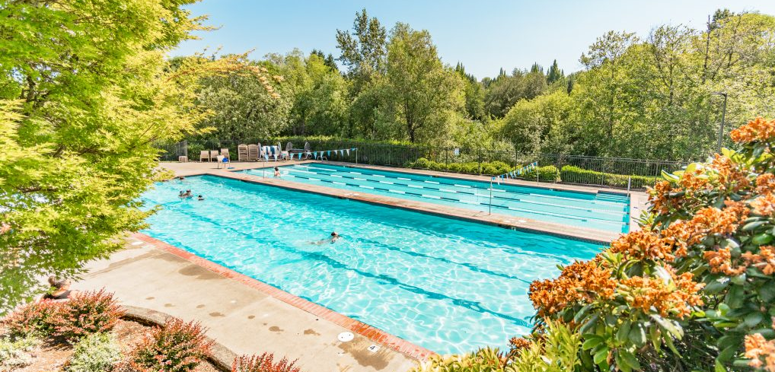
MRA Annual Meeting 2026
March 10, 2026

Slide 2
Agenda
Roll Call
Proof of Notice of Meeting
Tax Resolution 70-604
Introductions and Officer Reports
  Treasurer's Report
  Activities and Programming
Election of two Directors
Question & answer
Adjournment

Slide 3
Proof of notice
SAVE THE DATE
Murrayhill Recreation Association – Annual Homeowners Meeting March 10th 2026 at 6:30 pm
mailed on feb. 9th 2026
The MRA Board of Directors invite you to attend the MRA Annual Homeowners Meeting on Tuesday, March 10, 2026 at 6:30 pm in the HTC. The MRA Board of Directors will conduct the annual elections and present a 2025 overview as well as an outlook for 2026.
The Board of Directors of the Murrayhill Recreation Association are hereby providing you notice that two (2) Residential Director positions on the Board of Directors will be available. The position of Meghan Rachmady & Susan Decker are expiring. The MRA board is made up of five Murrayhill homeowners who are elected to three year terms of office. Elections will be held at the Annual Meeting for two Board positions in March 2026. A nominating committee has been appointed by the Board for the purpose of nominating prospective Directors. Prospective Directors may also be nominated by a petition signed by at least 25 MRA Members; petitions must include a biographical statement by the nominee. For more information or to discuss your interest with the nominating committee please email am@murrayhillrec.com. The Board must receive all nominations, petitions and accompanying materials by Feb 27th, 2026.
Official notification of the MRA Annual Meeting including the candidate names and biographical statements will be emailed on or about March 2nd 2026.
If you have any questions, please contact the MRA Association Manager at (503) 579-0985.
Sincerely,
The MRA Board of Directors
2026 Murrayhill Recreation Association | 11010 SW Teal Blvd | Beaverton, OR 97007 | (503) 579-0985 | am@murrayhillrec.com

Slide 4
Tax revenue ruling 70-604
Revenue ruling 70-604 is a tax election that allows an association to take advantage of the lower tax rates associated with filing Form 1120, U.S. Corporate Tax Return rather than filing Form 1120H, U.S. Income Tax Return for Homeowners Associations. Generally, net Federal income tax via Form 1120 is taxed at 15% vs form 1120H which is taxed at 30%.
This election notifies the Internal Revenue Service that the Association plans on using the excess of member revenue over expenses for the current year in determining assessments for the coming year.
This election and resolution is required by the Internal Revenue Service and has been reviewed by our CPA for propriety.
RESOLUTION OF THE MURRAYHILL RECREATION ASSOCIATION
RE: EXCESS INCOME APPLIED TO THE FOLLOWING YEAR’S ASSESSMENT
REVENUE RULING 70-604
WHEREAS, the Murrayhill Recreation Association is an Oregon corporation duly organized and existing under the laws of the State of Oregon:
and
WHEREAS, the members desire that the corporation shall act in full accordance with the rulings and regulations of the Internal Revenue Service;
NOW, THEREFORE, the members hereby adopt the following resolution by and on behalf of the Murrayhill Recreation Association:
RESOLVED, that any excess of membership income over membership expenses for the year ended December 31, 2026, shall be applied against the subsequent tax year member assessment as provided by IRS Revenue Ruling 70-604.
This resolution is adopted and made a part of the minutes of the meeting of March 10, 2026.

Slide 5
Read in Motions
2026 budget
The 2026 budget was approved by the board of directors and read into the January meeting minutes.
Copies of the budget can be provided per request.
The end of year revenue will be deposited into the reserve account

Slide 6
Treasurer's Report
Operating and Reserve Funds
Reserve projects
Separation of functions

Slide 7
2025 budget vs actuals
Summary of budget:
Operating:
Total Income: $557,579.49
Total Expenses: $498,439.24 ​
Net Operating Income: $59,140.25
Reserve:
Total Reserve Income: $374,532.57 ​
Total Reserve Expenses: $270,462.45 ​
Net reserve Income: $103,948.26
Net Income: $163,088.51
For more details see:
Notes:
How do we establish Useful Life and Remaining Useful Life estimates?
1) Visual Inspection (observed wear and age)
2) Association Reserves database of experience
3) Client History (install dates & previous life cycle information)
4) Vendor Evaluation and Recommendation
How do we establish Current Repair/Replacement Cost Estimates?
In this order...
1) Actual client cost history, or current proposals
2) Comparison to Association Reserves database of work done at
similar associations
3) Vendor Recommendations
4) Reliable National Industry cost estimating guidebooks
Association

Slide 8
2026 approved budget
Summary of budget:
Operating:
Total Income: $544,571.44
Total Expenses: $511,431.00 ​
Net Operating Income: $33,140.44
Reserve:
Total Reserve Income: $394,496.52 ​
Total Reserve Expenses: $253,375.80 ​
Net reserve Income: $141,120.72
​Net Income: $174,261.16 ​
For more details see:
Notes:
How do we establish Useful Life and Remaining Useful Life estimates?
1) Visual Inspection (observed wear and age)
2) Association Reserves database of experience
3) Client History (install dates & previous life cycle information)
4) Vendor Evaluation and Recommendation
How do we establish Current Repair/Replacement Cost Estimates?
In this order...
1) Actual client cost history, or current proposals
2) Comparison to Association Reserves database of work done at
similar associations
3) Vendor Recommendations
4) Reliable National Industry cost estimating guidebooks
Association

Slide 9
Annual Reserve Study
Performed by an independent company: Association Reserves
This year’s study included site visits of the association property
  Site visits are included every couple of years
Reserve study delivers on three key components:
Component List
  Defines the scope and schedule of all your anticipated upcoming Reserve projects
Reserve Fund Strength
  Reported in terms of "Percent Funded"
Reserve Funding Plan
  “Reserve funding is not "for the future". Ongoing Reserve transfers are intended to offset the ongoing, daily deterioration of your Reserve assets. Done well, a stable, budgeted Reserve Funding Plan will collect sufficient funds from the owners who enjoyed the use of those assets, so the association is financially prepared for the irregular expenditures scattered through future years when those projects eventually” require replacement”
Oregon Law, ORS 94.595, requires MRA to do a Reserve Study annually and to follow the direction of the study to ensure financial viability of the association!
Notes:
How do we establish Useful Life and Remaining Useful Life estimates?
1) Visual Inspection (observed wear and age)
2) Association Reserves database of experience
3) Client History (install dates & previous life cycle information)
4) Vendor Evaluation and Recommendation
How do we establish Current Repair/Replacement Cost Estimates?
In this order...
1) Actual client cost history, or current proposals
2) Comparison to Association Reserves database of work done at
similar associations
3) Vendor Recommendations
4) Reliable National Industry cost estimating guidebooks
Association

Slide 10
2026 MRA Reserve Study
MRA Component List:
  List all components under the ownership of the association
  The current annual deterioration of our reserve components is $195,854
  The reserve study recommended 2026 expenses out of reserves of $300,000.
    The MRA reviewed those recommendations and approved about $200,000 for 2026 budget
2) MRA Reserve Fund Strength:
  MRA Reserve Fund goal: $1,000,000
  Actual MRA Reserve Fund at time of Reserve Study: ~$ 171,000
  At current levels the MRA Reserve Fund is considered “Weak” for cashflow problems.
  MRA was able to transfer an additional ~$200,000 from 2025 budget into Reserves!
3) MRA Reserve Funding Plan:
  “The objective of your multi-year Funding Plan is to fund your Reserves to a level where you will enjoy a low risk of such Reserve cash flow problems” (>70% funded)
  Based on 2025 transfer, approved 2026 MRA budget, and the approved additional ¼% assessment on property sales, MRA is targeting to reach Low-Risk status over the next 5 years!
2026 Reserve Study prepared by:

Slide 11
Operating and Reserve Funds
Two types of funds within MRA
  Day-to-day operations are taken care of by the Operating Fund
  Major or long-term projects are handled by the Reserve Fund
Separate Bank Accounts
  An Operating account maintained at Bank of America
    The mra holds separate payroll, operating and savings accounts here
  A Reserve Account maintained at OnPoint Credit Union
Accounting and bookkeeping
The mra contracts with an independent accountant
  The accountant reconciles the accounts, Maintains accurate, up-to-date records of transactions
  The accountant has full access to quick books records and read only access to bank records
The board maintains a treasurer who audits, advises and works with the manager
  The treasurer runs monthly reports and presents to the board at monthly meetings

Slide 12
Reserve Fund
This fund is used for larger scale projects
  Replacement and repair plus unpredictable items over Reserve Threshold*
  Strict criteria for use based on:
    Community bylaws
    State regulations
    Decisions of the Board
  used to pay for expenditures that Don't occur on an annual basis or Fall under special exemptions
Some examples of reserve fund use are:
  Roof replacement on common area buildings
  Pump/CHEM room project at the pool
  New playground equipment
  Replacing fencing in MRA controlled areas
  Painting of MRA owned buildings, such as the Hometown Center
  Major projects, INCLUDING POOL RESURFACING
  Construction and major renovation such as PARKING LOT projects
*Reserve Threshold is currently $500. It is a value set by the board and subject to change.

Slide 13
Operating Fund
This fund is used to pay for the services that help carry out the everyday functions of the MRA. These include, but are not limited to:
  Contracted services
    Landscape maintenance/insect treatment
    General maintenance of common areas < Reserve Threshold
      Gate, fence, pool, lighting, and plumbing repairs
    General Pool maintenance
    Accounting + Legal
  Property management of Hometown Center
  Insurance and taxes
  Utility expenses
    Gas, electric, garbage and water
    Internet/phones (costs shared with MOA)
  Office expenses
    Postage, office supplies
  Staff Salaries (director of operations, lifeguards, pool monitors)
*Reserve Threshold is currently $500. It is a value set by the board and subject to change.

Slide 14
Dues & Special Assessment
Special assessment is determined by the board with our outside reserve study company
  Ensures there will be enough funds to repair/replace capital items when they wear out
  The reserve study looks out 30 years and ensures the Reserve Fund never gets too low
The 2025 special assessment was $ 650.00 yearly
the 2026 special assessment was lowered to $303.76 BILLED BIANNUALLY = $607.52 yearly
The 2025 dues were $242.25 billed biannually = $484.50 yearly
The 2026 dues were raised per the bylaws by 4% to $250.24 billed biannually= $500.48 YEARLY
  THE DUES AND ASSESSMENT FOR 2026 WILL BE AS FOLLOWS:
  $554.00 due no later than April 30th, 2026
  $554.00 due no later than October 31st, 2026

Slide 15
Title transfer fee & capital buy in
The board voted unanimously to implement an additional fee during the January 2026 bod meeting. The fee was read into the minutes by way of the 2026 budget approval.
The existing administration fee of $1500 will remain and be deposited into the MRA operations account at Bank of America.
for any home that is under contract on or after April 1st, 2026, An additional quarter of a percent of the sale price of the home will be assessed to the buyer at the time of closing.
  This capital buy in fee will be deposited into the MRA reserve money market account at On Point Credit Union.
The reserve account will be used for both current & future capital expenditures.

Slide 16
Recent Capital reserve projects
Tennis and pickleball court repair and restriping
  The courts now have additional pickleball lines and cracks were repaired
Chemical and pump room upgrades
  Due to changes in the Oregon health authority regulations, upgrades were required to stay compliant involving the chemical and pump systems. The new systems will provide long term cost savings and stabilize the pool chemistry resulting in fewer unplanned closures.
HTC bathroom floor replacement
  The slate tile floors were deteriorating and posed a safety hazard. They have been replaced with an epoxy coating.
HTC bathroom refresh
  The stall partitions were removed and powder coated. They look new and will be easier to clean.
Replacement of outdoor benches
  Benches around the sport courts had dry rot. the bench slats were replaced.

Slide 17
Capital reserve projects 2026
projects that are currently planned for the remainder of 2026 and 2027
Replacement of htc chimney caps that are leaking and have rust/erosion
Repair of Htc siding, windowsill & soffit with fresh paint
Replacement and restriping of Parking lot asphalt
Aerate and top dressing of field
Upgrades to electrical system in pool chemical and pump rooms
Replacement of lighting in office building to led
Repair of sidewalk lifts around the mra property
Replenishment of bark and playground chips
Removal of dead or dying trees
  Replacement of trees and vegetation on mra property as needed

Slide 18
activities and programming
2026 Activities schedule
Aquatics programs

Slide 19

2026 Community Activities
April 4 Easter Egg Hunt - 10:00 am
April 18 dumpster & Recycle event
Jun/jul/aug flicks on the field/while you float
August 4 national night out
December visit from santa
Please contact Kristin Kebbe, director of operations, if you would like to Sponsor or Volunteer for these events or would like to create a new event.

Slide 20

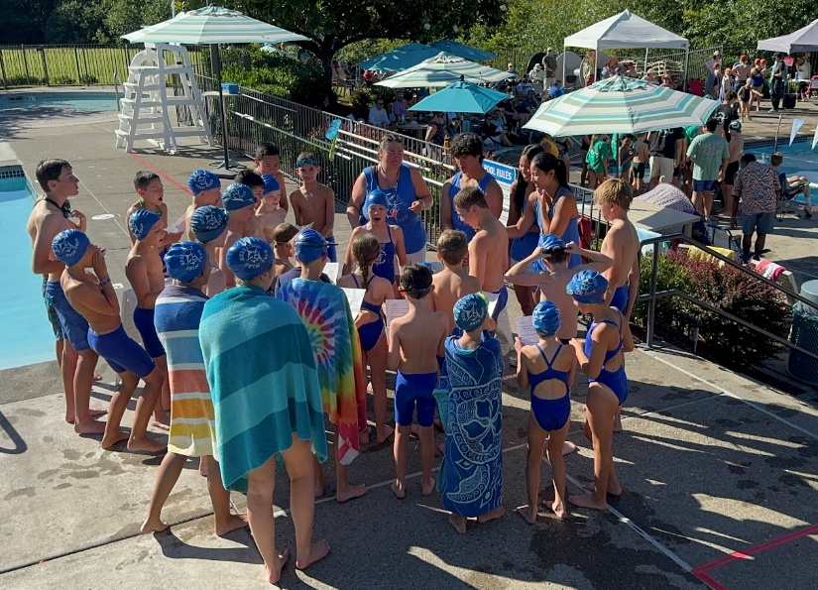
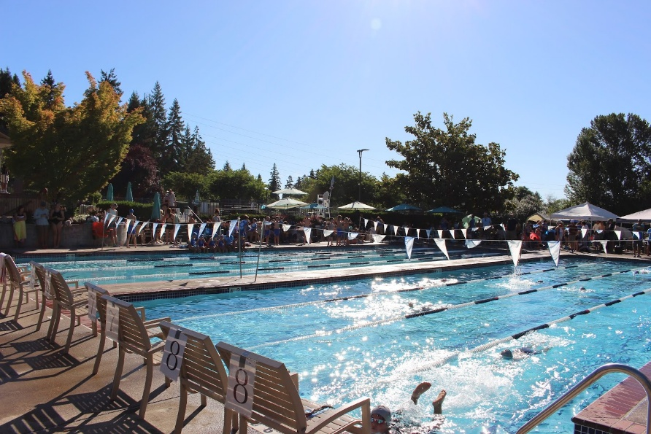
Aquatics Programs
Murrayhill Marlins Swim Team
  Parent meeting June 18th in the HTC
Swim Lessons
  Level 1-6 group lessons
REGISTRATION OPENS MAY 22 AT 12:00PM

Slide 21
Election of two MRA Board Members
Susan Decker
Meghan Rachmady

Slide 22
Question and answer

Slide 23
Adjournment

